Slide 1
IT Challenge 2021
The 1st international student competition dedicated to technological innovation

Slide 2
IT Challenge Overview

Slide 3
What is the challenge all about?
An international competition For students from all around the world in Austria, Croatia, China, France, Germany, India, Malaysia, Mexico, Netherlands, Russia, Spain, Turkey, UK, US…
Support for the Student teams from experts in the Scientific Community To help the students in developing their ideas
A challenging contest
Challenging not only student's innovation qualities but also development and business, offering an unique learning experience
An amazing reward program
1st : 10,000€
2nd : 5,000 €
3rd : 3,000 €
+ Invitation to the Awards Ceremony
+ Work experience and opportunities within the Atos Group

Slide 4
Challenge Goals
Increased registrations of teams in comparison to 2020 IT Challenge
2020 consisted of 103 teams from 58 universities across 19 countries
We want to further enhance engagements with our partner/target Universities and “Grandes Ecoles” to promote the challenge and support in organizing Campus events with collaboration with local campus teams
Target Tier One Universities in your country/region contact the Tier One Schools identified in your region to enhance or create new partnerships
Improve the quality of the ideas submitted supporting Atos’ ambitions. We provide detailed guidance to the students on what is expected from them, on the selection process (submission deadlines, Jury 1 and 2, the development phase) and support the SC team coaches during the development phase
Strengthen our presence on all social media platforms – Twitter, Facebook, LinkedIn

Slide 5
IT Challenge 2021 10th Edition

Slide 7
The theme… How digital can decarbonize non-digital
Pathways to digital decarbonization in business processes
The Paris Agreement sets out a global framework to avoid dangerous climate change by limiting global warming to well below 2°C and pursuing efforts to limit it to 1.5°C. In order to achieve this it is necessary to reduce atmospheric greenhouse gases, particularly Carbon Dioxide. This is especially true in the area of energy production and usage; by increasing the share of low-carbon energy sources, especially renewables, with a corresponding reduction in the use of fossil fuels

Slide 8
The theme: Areas of Decarbonization
Following the investor day where we announced our decarbonization ambition, our CEO Elie Girard wanted the contest to focus on solutions to digitally decarbonize non-digital elements such as business processes.

Slide 9
The theme: Areas of Decarbonization
The following topics may be areas to explore when considering how digital solutions can support decarbonization initiatives.
Power generation and demand - Supporting a shift to nuclear, hydro, biofuels, geothermal, solar, wind and tidal forms of generation.
Power use and efficiency - Local power generation, distribution and community schemes; Use of energy storage solutions such as high-capacity batteries for homes; Use of digital technology to match demand to the supply of clean energy.
Industry - Helping to optimize or reduce the usage of steel and cement, as production of these materials results in large emissions of greenhouse gases.
Agriculture and farming - The use of inorganic fertilizers releases methane into the atmosphere. Additionally, Livestock farming (particularly cattle) produces large volumes of methane. Can we reduce these emissions, or use digital technologies to make better use of waste methane? How can digital technology help to prevent the destruction of rainforests, or aid in the recovery of deforested areas?
Transport - Can digital technology support a shift from fossil fuels to electricity or hydrogen? How can digital technology maximise the use of public transport, car sharing and rental schemes? Can digital aid the distribution and delivery networks supporting increased online product and grocery shopping? How can digital reduce emissions in shipping or air travel?
The environment - How can digital solutions help us develop and use carbon capture and storage technologies.

Slide 10
The Challenge: Decarbonization
This year’s Atos IT Challenge seeks to develop digital solutions that will support multiple areas of decarbonization and decarbonization initiatives, helping companies and society as a whole to tackle climate change.
The Challenge is to develop a functioning application, mobile app, service or simulation to support industry, commerce or individuals in the drive for decarbonization.
We are looking for interesting applications that could have immediate and impactful real-world applicability.

Slide 11
Examples and Ideas Decarbonization
The following are initial ideas for possible competition entries, but the challenge is certainly not limited to these:
Applications to analyse climate data, perhaps using AI/ML techniques.
Modelling of energy (particularly electricity) distribution to meet future demands, perhaps bearing in mind weather forecast data.
Applications for individuals to inform and support decisions around energy supply, transport and diet.
Modelling tools match the supply of renewable electricity with the demand, perhaps involving battery or other storage mechanisms.
Soil management systems for agriculture.
Applications to track carbon in the supply chain and improve efficiency in commercial scenarios.
Applications to analyze the impact of Covid-19, such as increased remote working, on levels of CO2 in the environment.
Modelling of large-scale systems, such as shipping routes.
Carbon monitoring dashboards and information systems in the commercial environment, including the tracking of raw materials, premises lighting and heating, and staff travel.

Slide 12
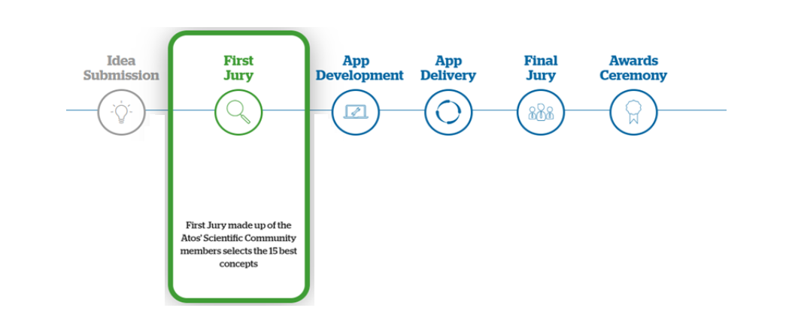
Timeline of the challenge
Registration opens 21st September 2020 – 30th November 2020 Students submit their innovative ideas based on decarbonization
1st December 2020 – 15th December 2020
16th December 2020 – April 2021
Shortlisted teams work on developing their solution with support of SC coach
April 2021 Testing in Atos Competencecenter
May 2021 Shortlisted team pitch their solutions to a jury panel who will select the 3 finalist teams
July 2021 The 3 finalist teams are invited to the contest awards ceremony

Slide 13
Criteria to get the points for the development phase
First jury roadmap
Alignment with the theme 5pts
Benefit of the service for end-users (Usefulness, novelty) 5pts
Benefit of the service for business partners 5pts
Personal feeling (Originality, I like it…) 5pts
Reality of business model (Feasibility, market size, risks, ...) 5pts
Technical feasibility (Architecture, project plan…) 5pts

Slide 14
Promotion

Slide 15
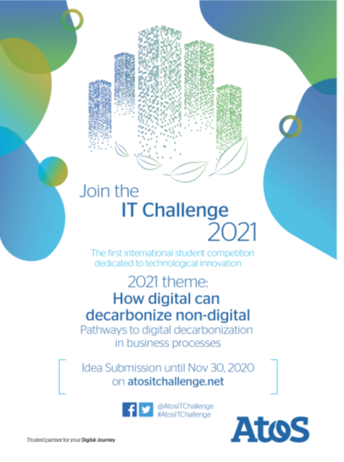
Materials and Promotions
2021 promotion kit available
Posters/flyers
Email signature
Editable text social Media cards
Banners
Contents on the Atos IT challenge website
Connection to Scientific Community members
#AtosITChallenge
facebook.com\AtosITChallenge
atositchallenge.net

Slide 16
Appendix Retrospective 2012-2020

Slide 17
Participation since 2012
IT Challenge program was launched in 2012.
In 2020 58 Universities in the competition from 19 countries.

Slide 18
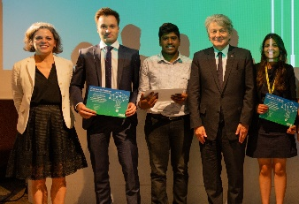
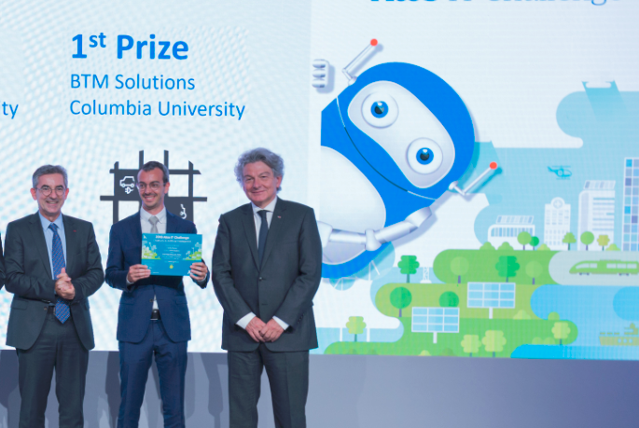
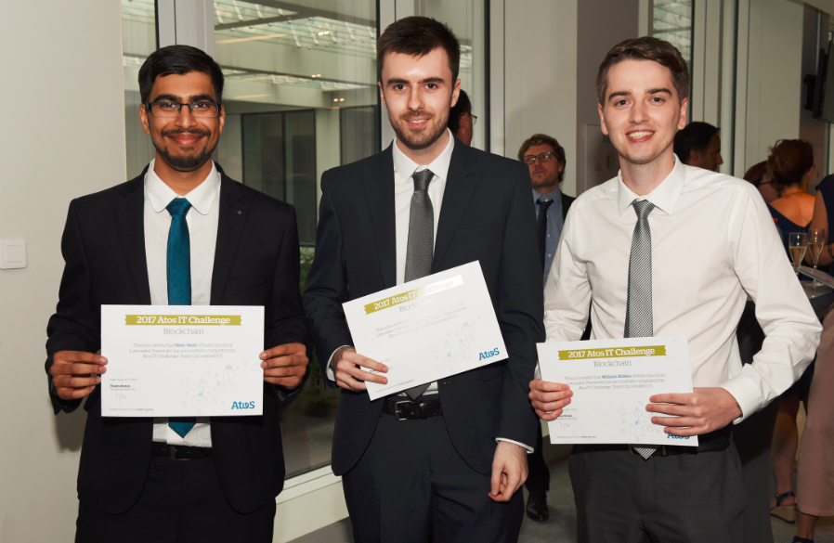
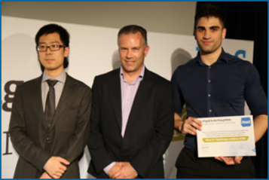
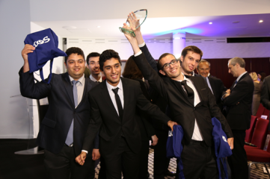
Back to finalists of the IT Challenge compete Overview of 2012-2019 winners
2019 – Machine Learning
for Sustainability
2018 – Chatbot & AI
2017 – Blockchain
2016 – Right to be forgotten
2015 - connected living
1st Prize Farmero
From TECHNISCHE UNIVERSITAT BERLIN
Germany
Farmero is an innovative and easy-to-use Application for small farms which delivers up-to-date and reliable disease-risk-assessments.
1st Prize: 'BTM'
From COLUMBIA UNIVERSITY, USA
Developed a service presenting how AI and chatbots can be used in automated demand response applications for connected objects, reducing costs and environmental footprint.
1st Prize: Quo
from LANCASTER UNIVERSITY, UK
Developed a visual tool to intuitively create ‘smart contracts’ that anyone can deploy, without ever needing to write a single line of code.
1st Prize: Breadcrumb from Loughborough UNIVERSITY, UK
The app that makes it easy for people to manage their online reputation through a sentiment analysis algorithm and "credit scoring" features, and provide insight.
1st Prize: Comfort train
From ENSEIRB MATMECA, France
The app that helps travelers find the least crowded carriage to sit in. It has been designed so that new train and tube networks can easily be added. So it can be used wherever you are traveling.

Slide 19
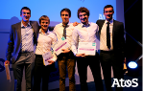
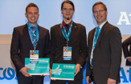
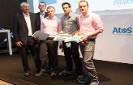
Back to finalists of the IT Challenge compete Overview of 2012-2018 winners
2014 Rio 2016 -Olympic & Paralympic Games
2013 - Connected Car
2012 - Smart Mobility
1st Prize: Eirb-Dev
From ENSEIRB MATMECA, France
The app helps you to plan your day of sport and sightseeing based on your preferences.
1st Prize: Evergreen
From HAGENBERGEN UNIVERSITY, Austria
The app reduces the car gas emissions and the time the driver has to wait in front of the traffic red lights, by requesting the best speed for phased traffic lights, based on the current navigation route.
1st Prize: Multilens
From FONTYS HOGESCHOOL, NL
The app allows for a different viewing experience when visiting a sport event, concert or business conference, a true leverage of smart mobile devices.

Slide 20
More information
Follow the updates and stages of the challenge on:
@AtosITChallenge
#AtosITChallenge
atositchallenge.net
Atos IT Challenge

